Slide 1

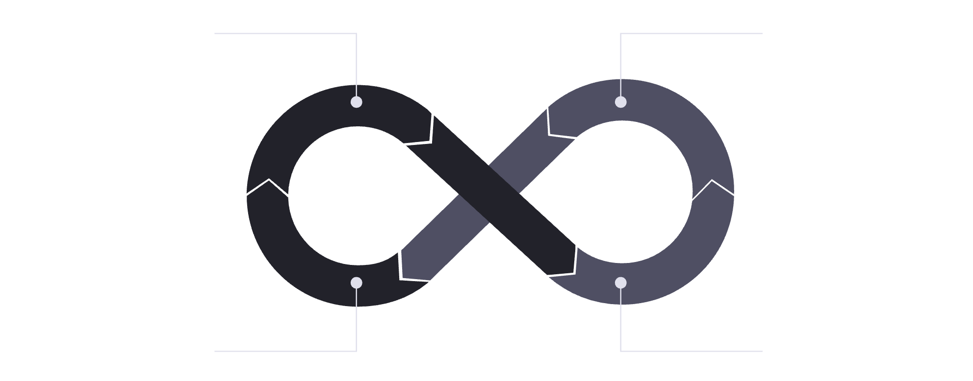
Telecom Churn War Room: From Insight to Save Actions
An Executive-Ready Narrative to Reduce Churn and Protect High-Value Revenue. This presentation outlines our comprehensive strategy to tackle customer churn, focusing on data-driven insights and actionable interventions to safeguard our most valuable customer segments.
Identify High-Value Segments
Analyze Churn Drivers
Monitor & Iterate
Design Save Actions

Slide 2




Our Toolkit: Powering Data-Driven Churn Analysis
Our comprehensive churn analysis framework leverages a suite of integrated tools to ensure robust data management, insightful analytics, and seamless deployment of solutions.
PostgreSQL
Microsoft Excel
Serves as our foundational data layer, handling ingestion, transforming raw data into star schemas, and creating materialized views for efficient BI querying.
Utilized for in-depth exploratory data analysis (EDA), detailed churn analysis, customer profiling, and understanding cohort behavior and add-on service impacts.
Power BI
GitHub Actions
The primary tool for business intelligence and storytelling, importing data, defining complex DAX measures, and crafting impactful, narrative-driven dashboards.
Powers our CI/CD pipeline, automating schema deployment, data refreshing processes, and ensuring continuous delivery of actionable insights to stakeholders.
Together, these tools form a cohesive ecosystem, enabling us to move from raw data to strategic insights and automated interventions with precision and efficiency.

Slide 3
Executive Summary
Key Performance Indicators
Understanding our current landscape is crucial for effective churn management. These core metrics highlight the scale of the challenge and the critical areas requiring immediate attention.
7,043
26.54%
33.03%
1,051
Total Customers
Overall Churn Rate
High-Value Churn Rate
New Customers (Last Qtr)
Our current customer base, representing our market presence.
The percentage of customers who have disconnected service, indicating retention challenges.
A critical metric, showing significant churn within our most profitable segment.
New acquisitions during the previous quarter, balancing churn with growth.
Our immediate focus is on the high-value churn rate, which significantly impacts our top line revenue.

Slide 4



Identifying Core Churn Drivers
Our analysis reveals three primary factors contributing to customer churn. Addressing these specific pain points will be key to developing targeted retention strategies.
Month-to-Month Contracts
Fiber-Only Subscriptions
Lack of Add-Ons
Customers on flexible, month-to-month plans exhibit a significantly higher propensity to churn. The lack of contractual commitment makes it easier for them to switch providers, highlighting the need for incentives to transition to longer-term agreements.
Customers with only fiber internet service, without additional bundled products, show increased churn. This suggests that a single-service relationship offers less stickiness, making them more susceptible to competitor offers or perceived value issues.
Customers who have not adopted any additional services or add-ons (e.g., streaming packages, security features, tech support) are more likely to churn. Bundled services create greater perceived value and increased switching costs, fostering loyalty.
Each of these drivers presents a clear opportunity for intervention through strategic offers and improved customer engagement.

Slide 5
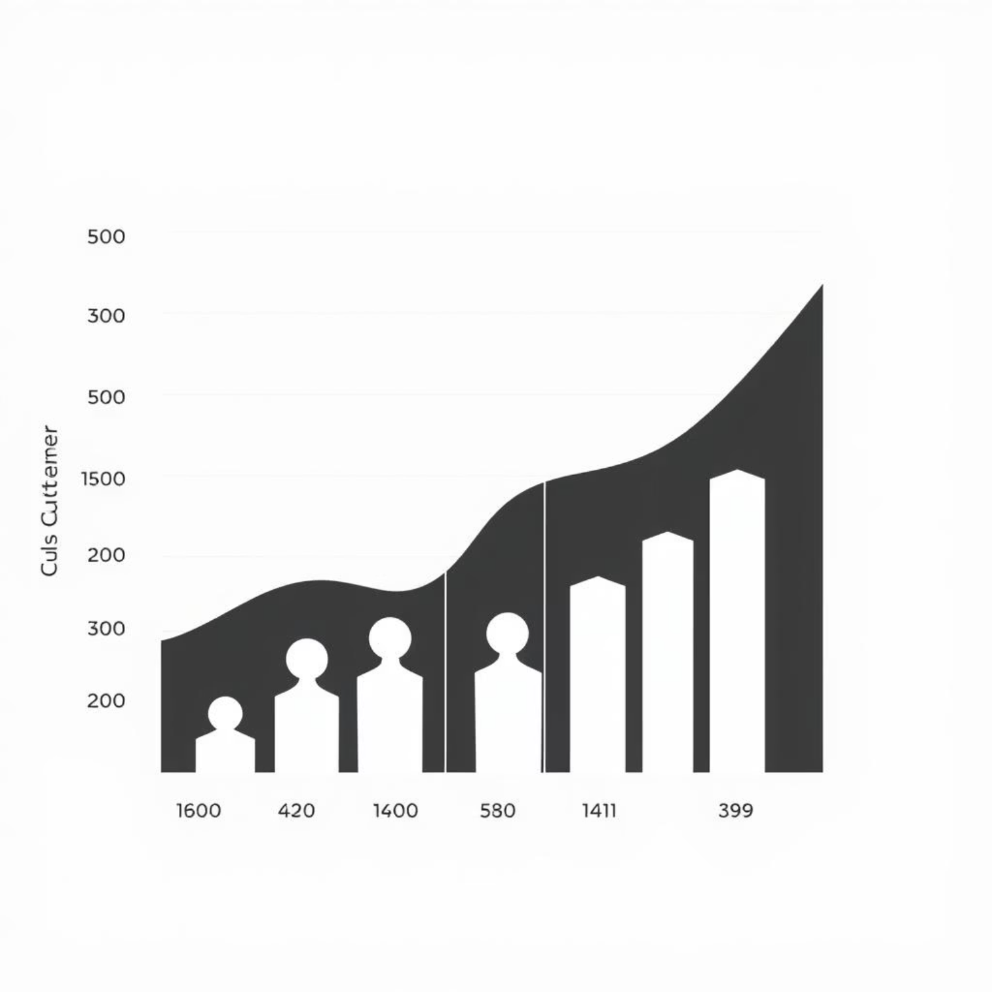
Who's At Risk? Profiling High-Value Customers
Our most valuable segment, while crucial for revenue, also shows the highest churn rate. Understanding their profile is vital for focused retention efforts.
We have identified 1,762 high-value customers within our base, representing a significant portion of our recurring revenue. Their churn rate of 33.03% is alarming and demands immediate, tailored strategies.
A deep dive into this segment reveals common characteristics that make them particularly vulnerable:
Primarily on month-to-month contracts.
Often subscribe to fiber internet as a standalone service.
Minimal or no additional services/add-ons.
Likely to be digitally savvy and responsive to competitor offers.
Protecting this segment is paramount to stabilizing our revenue base.

Slide 6
Where to Act: Retention Target List
To maximize our impact, we've prioritized high-value customers for immediate retention efforts. The following table showcases a sample of our top 50 targets based on their monthly charge, highlighting their potential impact on revenue.
CUST001
150.00
Month-to-Month
Fiber
0.85
CUST002
145.50
Month-to-Month
Fiber
0.82
CUST003
140.00
Month-to-Month
Fiber
0.80
CUST004
138.25
Month-to-Month
Fiber
0.78
CUST005
135.00
Month-to-Month
Fiber
0.75
The full mv_retention_targets list contains 50 high-value customers prioritized by monthly charge, allowing for precise, one-to-one outreach. This targeted approach ensures our efforts are focused on the customers who matter most to our revenue protection goals.

Slide 7
What to Do: Strategic Offer Design
Our retention strategy is built on three key pillars, each designed to address specific churn drivers and enhance customer value. These offers are tailored to incentivize stickiness and broaden the customer relationship.
1
2
3
Contract Migration Incentive
Value Bundle Promotion
Payment Method Nudges
Objective: Convert Month-to-Month (M2M) customers to annual contracts.
Objective: Increase stickiness for fiber-only customers through attractive bundles.
Objective: Improve retention by encouraging automated, reliable payment methods.
Offer: Provide a significant discount (e.g., 15-20% off monthly bill) or a premium upgrade (e.g., speed boost, free add-on for 6 months) for signing an annual agreement. This reduces churn risk by locking in commitment.
Offer: Promote bundled services like Online Security and Premium Tech Support for a nominal add-on fee (e.g., $5-$10/month). This not only adds perceived value but also integrates customers more deeply into our ecosystem, making switching harder.
Offer: Incentivize customers to switch to auto-pay and paperless billing with a small, recurring discount (e.g., $5 credit for 3 months). Automated payments reduce involuntary churn due to failed payments and enhance customer convenience.
These targeted offers aim to transform at-risk customers into long-term, satisfied subscribers.

Slide 8
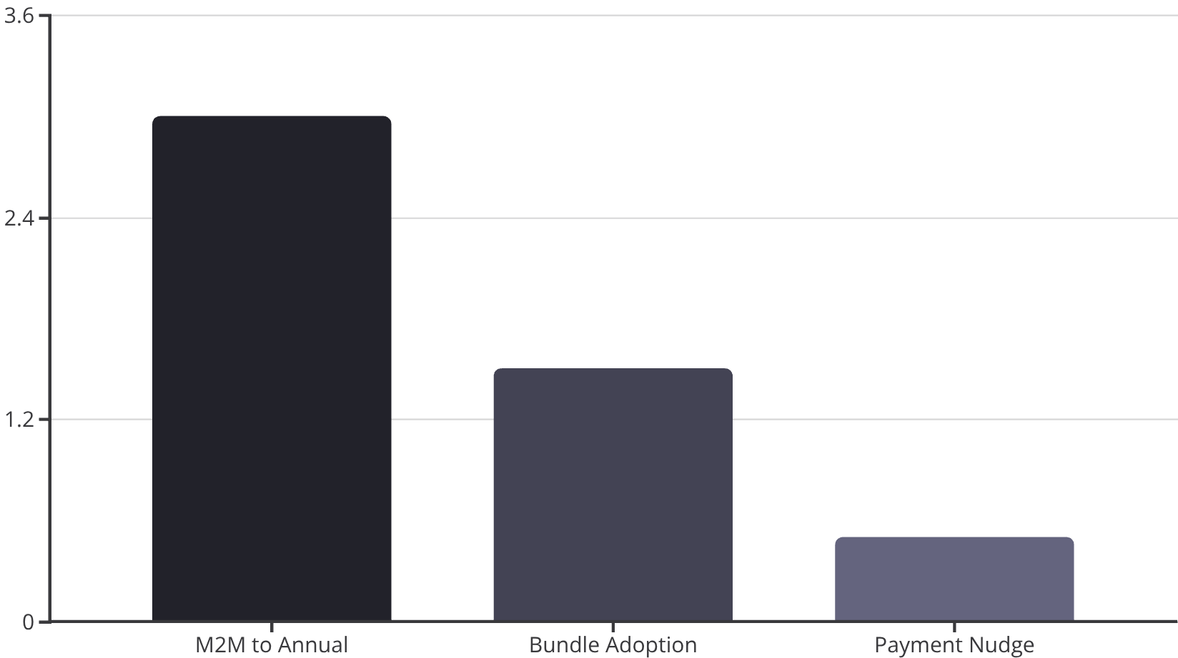
Projected Impact: Churn Reduction Model
Based on conservative assumptions, our proposed interventions are expected to yield tangible reductions in overall churn, especially within the high-value segment.
We project a significant positive impact across our customer base by strategically deploying the retention offers. Each initiative targets a specific churn driver, leading to a cumulative reduction in our overall churn rate.
M2M to Annual Migration: Assuming a 25% migration rate, we expect a -3 percentage point reduction in churn for this segment.
Bundle Adoption: With 15% of fiber-only customers adopting a bundle, we anticipate a -1.5 percentage point reduction in their churn.
Payment Method Nudge: A 10% adoption rate of auto-pay is projected to reduce involuntary churn by -0.5 percentage point.
These conservative estimates indicate a significant and measurable positive impact on our customer retention.

Slide 9
Key Takeaways for Revenue Protection
Our deep dive into churn reveals critical opportunities for protecting high-value revenue. By understanding the problem and focusing on targeted solutions, we can significantly improve our retention rates.
High-Value Churn is a Priority
Contract & Bundle Gaps
Targeted Offers are Key
The 33.03% churn rate among our most profitable customers demands immediate, focused attention to safeguard significant revenue streams.
Month-to-month contracts and fiber-only subscriptions are major churn drivers, signaling a need for stronger contractual ties and diversified service adoption.
Strategic offers like contract migrations, value bundles, and payment nudges are crucial for directly addressing these churn risks.
These insights form the foundation for our actionable churn reduction plan.

Slide 10
Next Steps: Implementation & Tracking
To effectively combat churn, we must establish clear ownership, timelines, and success metrics for each initiative.
Develop Offer Campaigns
Marketing Team
Q1 FY25 (Launch by End of Jan)
Offer uptake rate, M2M migration %. % of fiber-only customers converting to bundles
Train Retention Agents
Customer Service & Training
Mid-Jan FY25
Agent offer conversion rate, call handling time for retention cases
Implement Payment Nudge
Billing & Product Teams
Q1 FY25 (Automate by Feb)
Auto-pay enrollment rate, reduction in involuntary churn
Establish Reporting Dashboards
Analytics & IT
End of Jan FY25
Save Rate, High-Value Churn Rate, Time-to-Contact
Regular monitoring and agile adjustments will be crucial for the success of our churn reduction initiatives.

Slide 11

A Unified Approach to Churn Reduction
By moving from insight to concrete save actions, we are committed to protecting our high-value revenue and fostering long-term customer relationships. This war room initiative marks a decisive step in our strategic effort to secure our market position.

Slide 12



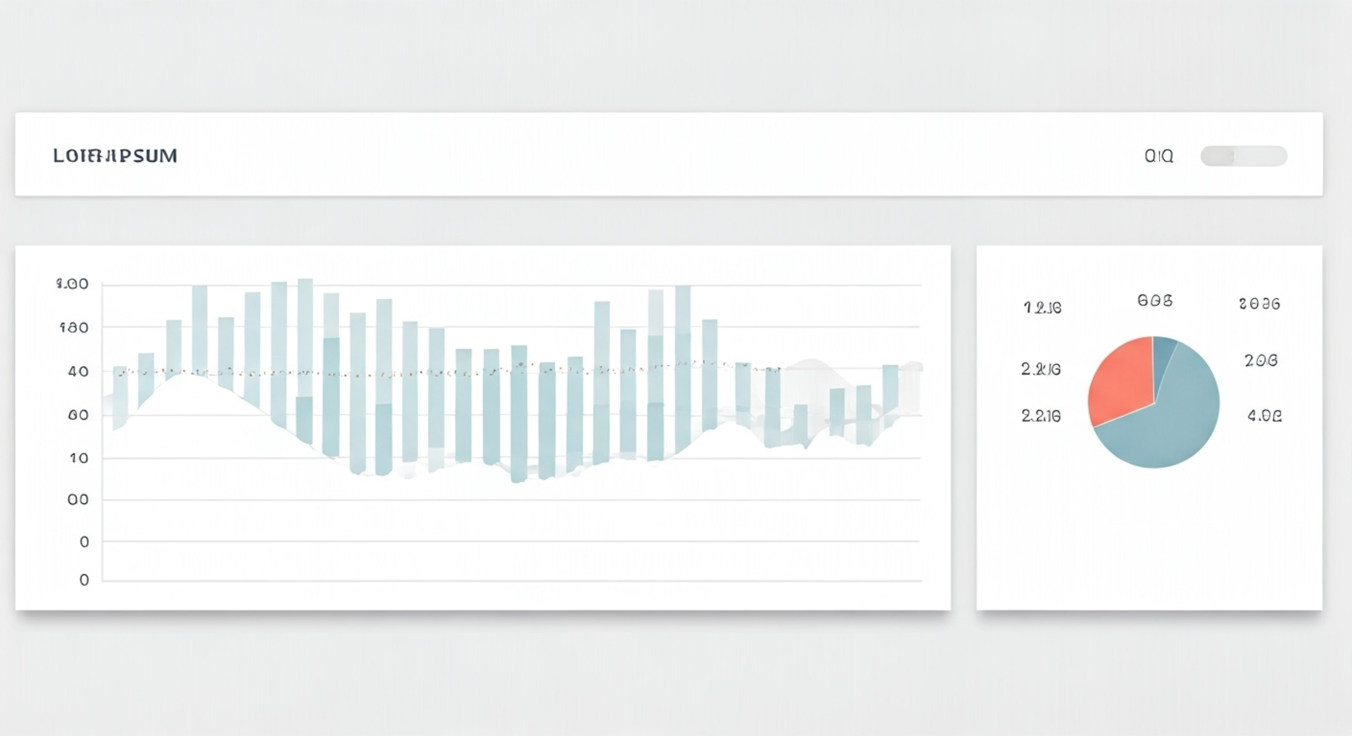
Dashboard Design Principles: Clarity & Actionability
Our churn reduction dashboard is meticulously designed to provide immediate insights and guide swift action, adhering to principles that prioritize user experience and data clarity.
Structural Foundation
Visual Simplicity
Intuitive Interaction
Built on a 12-column grid with generous padding, ensuring visual balance and scalable content presentation.
A strict maximum of two colors and prominent, large numbers for KPIs keep the focus on critical metrics.
Vertical slicers enable intuitive filtering, complemented by clear page navigation for a seamless user journey.
This user-centric design ensures rapid comprehension and effective decision-making from the dashboard.

Slide 13




Driving Retention: Your Call to Action
Our churn analysis has provided a clear roadmap. Now is the time for decisive action. We urge all stakeholders to explore the Power BI dashboard, leverage its dynamic insights, and proactively initiate these targeted retention strategies.
Deepen Insights
A/B Test Offers
Monitor KPIs
Continuously refine our understanding of churn drivers through ongoing data analysis and integrating direct customer feedback.
Systematically A/B test and optimize retention offers to maximize their effectiveness and return on investment.
Maintain vigilance with real-time KPI dashboards, ensuring agile and proactive responses to evolving churn trends.
Our collective commitment and sustained collaboration are paramount to securing long-term customer loyalty and protecting our high-value revenue.

Slide 14
Thank You & Questions
We appreciate your time and attention today. We hope these insights provide a clear path forward for enhancing customer retention and protecting our high-value revenue.
We are now ready to answer any questions you may have.
Email: sohilakhaled811@gmail.com
LinkedIn: linkedin.com/in/sohilakabbas
GitHub Repo: Customer Churn Analysis

